Slide 1
Parallel Processing in Python & Python Package Development

Slide 2
What is Parallel Processing and Sequential Processing
Parallel: Parallel processing is a computing technique when multiple streams of calculations or data processing tasks co-occur through numerous central processing units (CPUs) working concurrently.
Sequential: Sequential processing refers to the systematic handling of data one record or item at a time. It allows for the examination, transformation, and manipulation of data in a specific order, enabling meaningful insights and results to be derived.

Slide 3
Why Use Parallel Processing?
Benefits:
Faster execution
Efficient CPU utilization
Applications:
Large-scale data processing
Image/video rendering
Machine learning training

Slide 4
Python Libraries for Parallelism
threading – Lightweight, shared memory
multiprocessing – True parallelism, separate memory
concurrent.futures – High-level async execution
joblib, dask, ray – For advanced and distributed processing

Slide 5
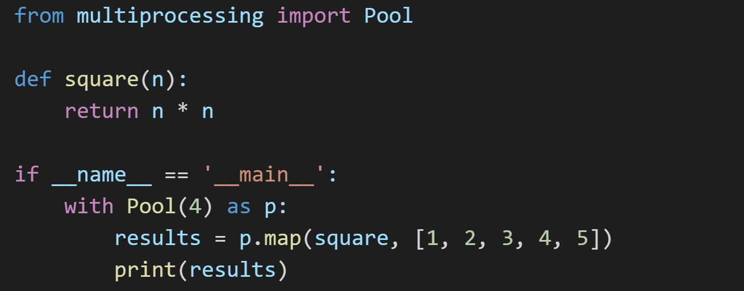
Code Example – Multiprocessing

Slide 6
Real-World Use Cases
Web scraping with multiple threads
Processing large log files
Data science with Dask and Pandas
Parallelized video encoding

Slide 7
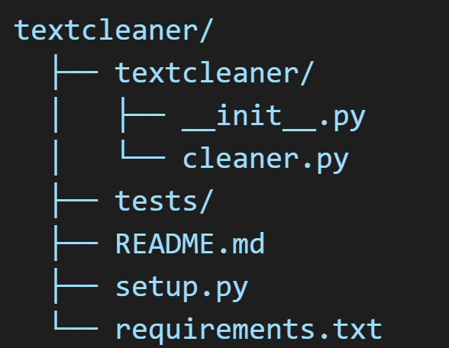
Creating a Python Package
Folder structure:
Why packages are useful: modularity, reusability

Slide 8
Your Package - textcleaner
Purpose: Clean and preprocess raw text
Functions: Lowercasing, Deduplication, Punctuation removal
Modules:
cleaner.py – Core functionality
_init_.py – Exports functions

Slide 9
Publishing to GitHub
Git Commands:
git init
git add .
git commit -m "Initial commit"
git remote add origin ...
git push -u origin <branch>
Repo link: https://github.com/Sanju-49/textcleaner

